Slide 1

One-Dimensional
Unconstrained Optimization
Chapter 13
Credit: Prof. Lale Yurttas, Chemical Eng., Texas A&M University

Slide 2
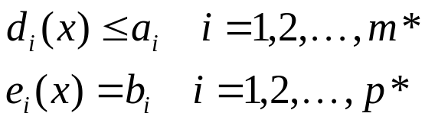
Mathematical Background
An optimization or mathematical programming problem is generally stated as: Find x, which minimizes or maximizes f(x) subject to
Where x is an n-dimensional design vector, f(x) is the objective function, d_{i}(x) are inequality constraints, e_{i}(x) are equality constraints, and a_{i} and b_{i} are constants
Optimization problems can be classified on the basis of the form of f(x):
  If f(x) and the constraints are linear, we have linear programming.
  If f(x) is quadratic and the constraints are linear,
  we have quadratic programming.
  If f(x) is not linear or quadratic and/or the constraints are nonlinear, we have nonlinear programming.
When equations(*) are included, we have a constrained optimization problem; otherwise, it is unconstrained optimization problem.

Slide 3
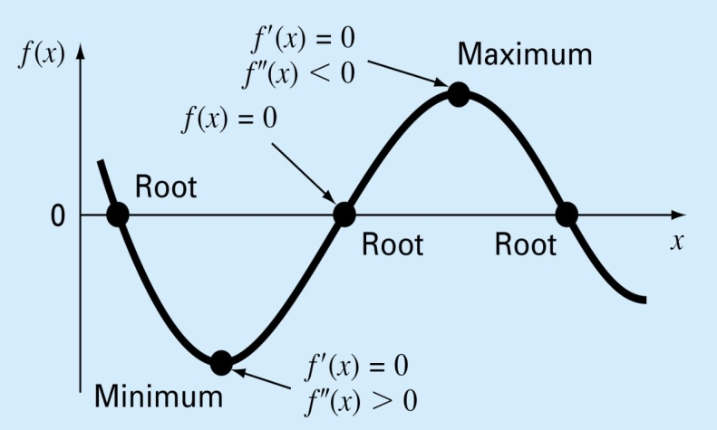
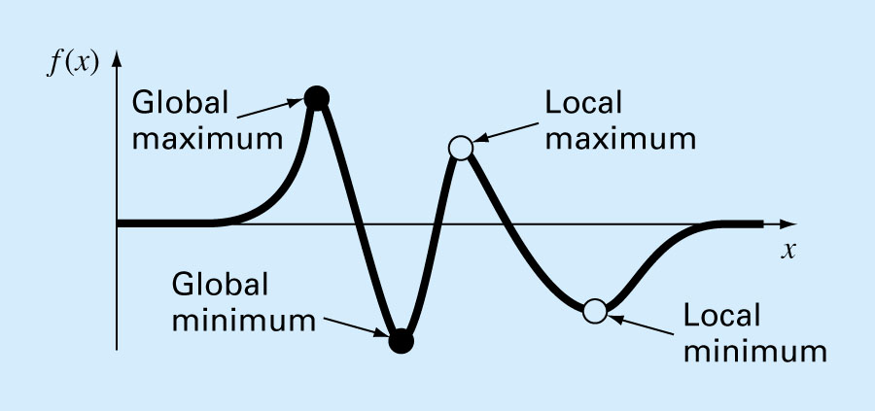
One-Dimensional Unconstrained Optimization
Root finding and optimization are related. Both involve guessing and searching for a point on a function. Difference is:
  Root finding is searching for zeros of a function
  Optimization is finding the minimum or the maximum of a function of several variables.
  In multimodal functions, both local and global optima can occur. We are mostly interested in finding the absolute highest or lowest value of a function.
How do we look for the global optimum?
By graphing to gain insight into the behavior of the function.
Using randomly generated starting guesses and picking the largest of the optima
Perturbing the starting point to see if the routine returns a better point

Slide 4
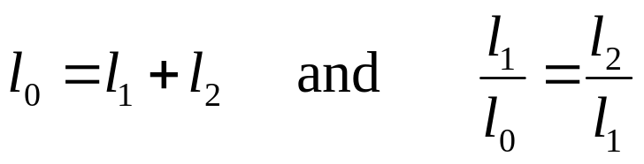
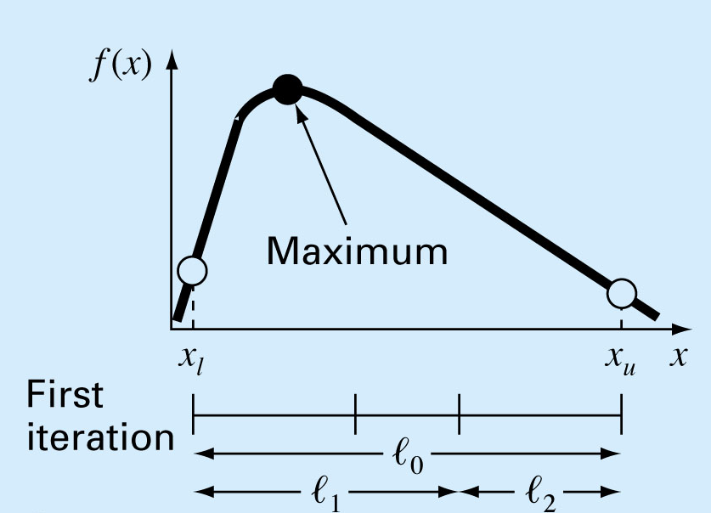
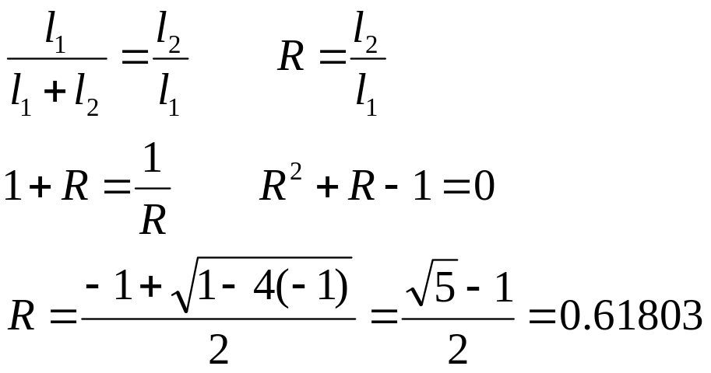
Golden Ratio
A unimodal function has a single maximum or a minimum in the a given interval. For a unimodal function:
  First pick two points that will bracket your extremum [x_{l}, x_{u}].
  Then, pick two more points within this interval to determine whether a maximum has occurred within the first three or last three points
Golden Ratio

Slide 5
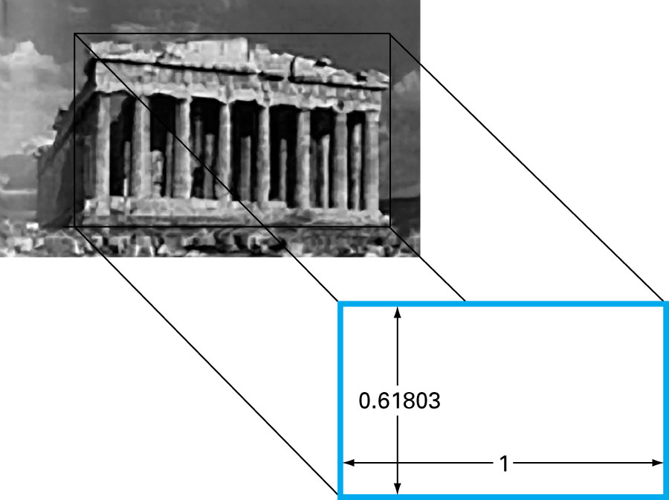
Golden Ratio
The Parthenon in Athens, Greece was
constructed in the 5th century B.C.
Its front dimensions can be fit exactly within a golden rectangle

Slide 6
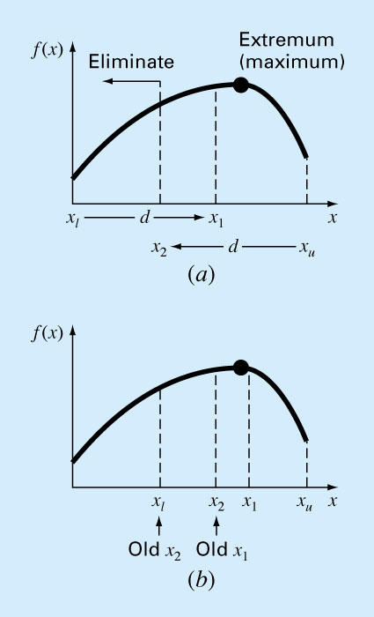
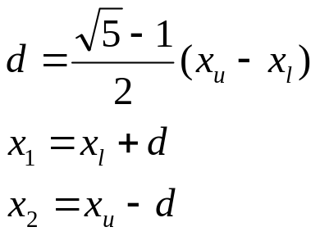
Golden-Section Search
Pick two initial guesses, x_{l} and x_{u}, that bracket one local extremum of f(x):
Choose two interior points
x₁ and x₂ according to
the golden ratio
Evaluate the function at x₁ and x₂ :
If f(x₁) > f(x₂) then the domain of x to the left of x₂ (from x_{l} to x₂) does not contain the maximum and can be eliminated. Then, x₂ becomes the new x_{l}
If f(x₂) > f(x₁), then the domain of x to the right of x₁ (from x₁ to x_{u}) can be eliminated. In this case, x₁ becomes the new x_{u} .
The benefit of using golden ratio is that we do not need to recalculate all the function values in the next iteration.
If f(x₁) > f(x₂) then New x₂ ⬅ x₁ else New x₁ ⬅ x₂
Stopping Criteria
| x_{u} - x_{l} | < ε

Slide 7
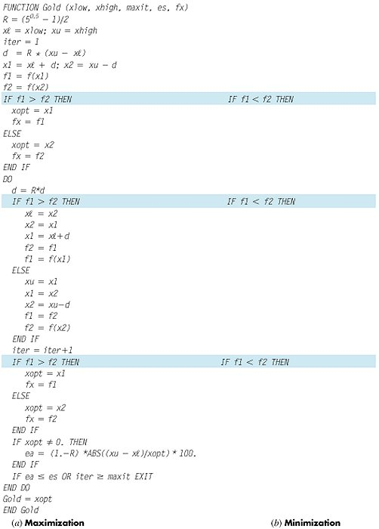
Fig 13.5

Slide 8
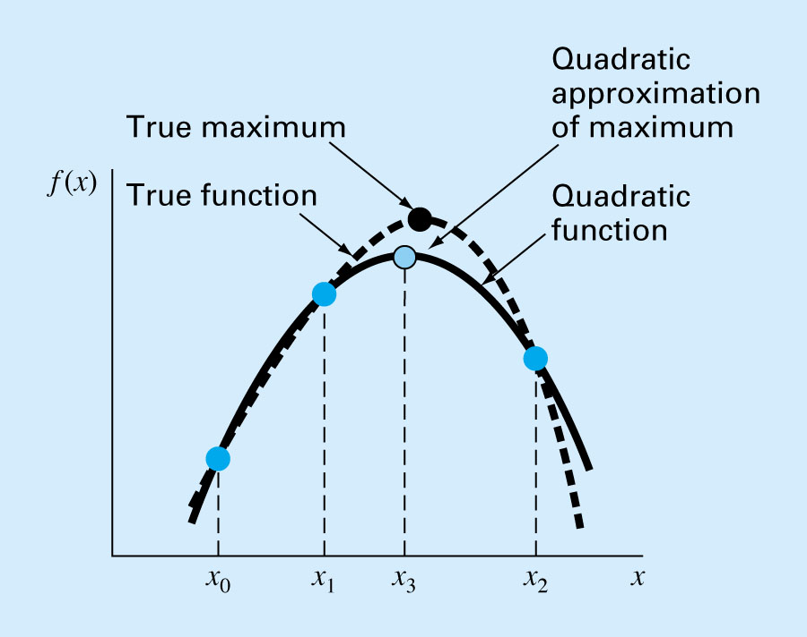
Finding maximum through
Quadratic Interpolation
If we have 3 points that jointly bracket a maximum (or minimum), then:
  Fit a parabola to 3 points (using Lagrange approach) and find f(x)
  Then solve df/dx = 0 to find the optimum point.

Slide 9
Example (from the textbook):
Use the Golden-section search to find the maximum of
f(x) = 2 sin x – x²/10 within the interval x_{l}=0 and x_{u}=4

Slide 10
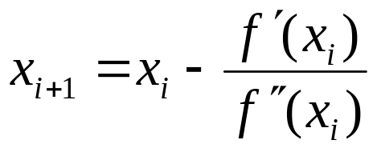
Newton’s Method
A similar approach to Newton- Raphson method can be used to find an optimum of f(x) by finding the root of f’(x) (i.e. solving f’(x)=0):
Disadvantage: it may be divergent
If it is difficult to find f’(x) and f”(x) analytically, then a secant-like version of Newton’s technique can be developed by using finite-difference approximations for the derivatives.

Slide 11
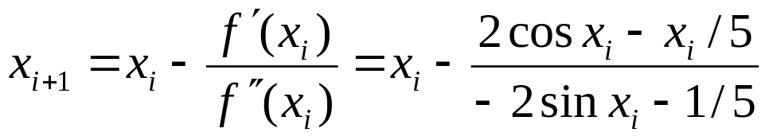
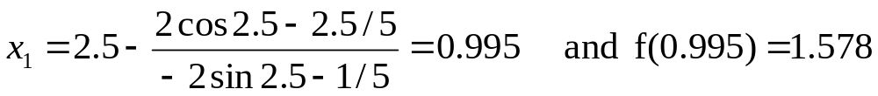
Example 13.3:
Use Newton’s method to find the maximum of
f(x) = 2 sin x – x²/10 with an initial guess of x₀ = 2.5
Solution:
i | x | f(x) | f’(x) | f”(x)
0 | 2.5 | 0.572 | -2.102 | -1.3969
1 | 0.995 | 1.578 | 0.8898 | -1.8776
2 | 1.469 | 1.774 | -0.0905 | -2.1896
3 | 1.4276 | 1.77573 | -0.0002 | -2.17954
4 | 1.4275 | 1.77573 | 0.0000 | -2.17952

